Slide 1
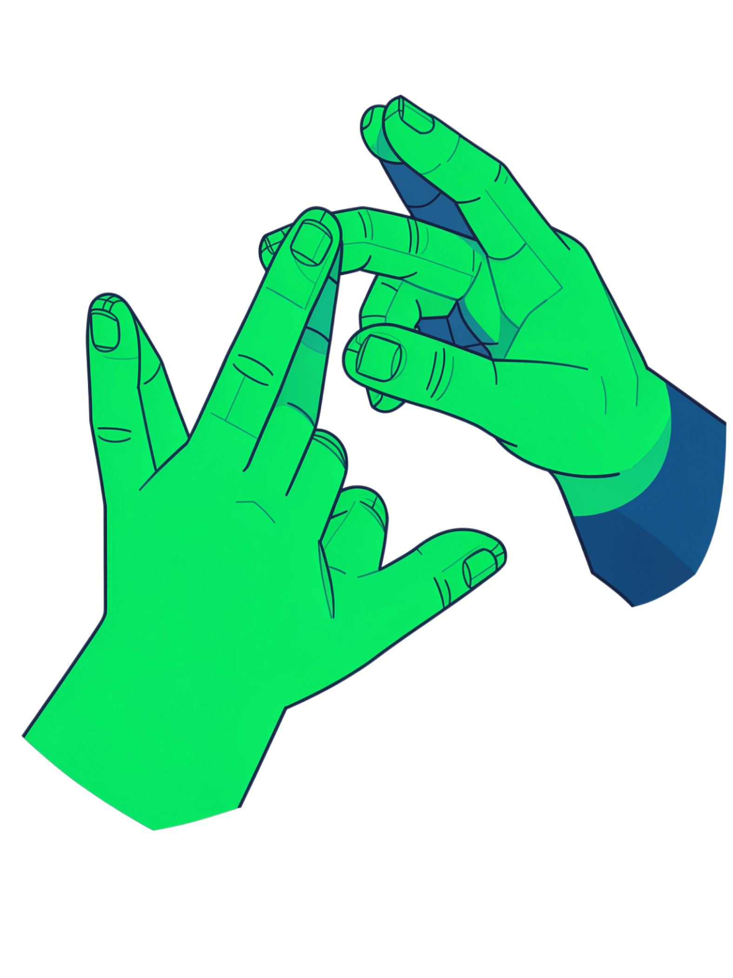
Sign Language Recognition
41-Class Deep Learning Project
MobileNetV2 • Transfer Learning • Fine-Tuning • OpenCV • MediaPipe
Image classification with a focus on real-world webcam challenges
Done by: Rashna, Francis, Sudeep

Slide 2
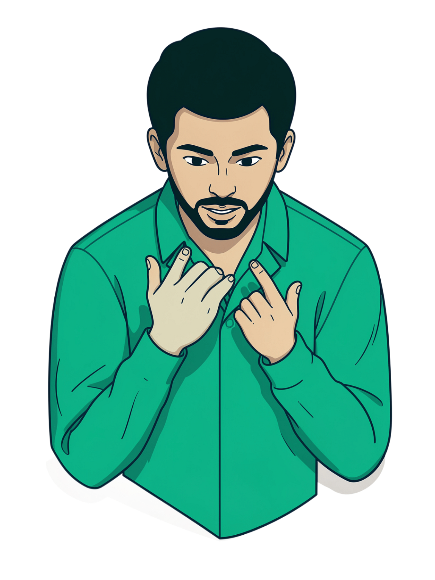
Why This Matters
Visual Language
Sign language communicates meaning through hand shapes, finger positions, and gestures — a rich, complex visual system.
Computer Vision Bridge
Computer vision can bridge the gap between visual signs and machine understanding, enabling new accessibility tools.
41-Class Scope
This project tackles 41 static sign-language classes with real-world robustness in mind — digits, letters, and common phrases.
The Core Challenge
Moving from controlled lab accuracy to practical webcam performance — the gap between benchmark and deployment.

Slide 3
Project Objectives
41 Classes
18,450 Images
Static sign-language categories spanning digits, letters, and common words
Balanced dataset with exactly 450 images per class for fair training
MobileNetV2
Real-Time Pipeline
Transfer learning + fine-tuning on ImageNet pretrained weights
OpenCV + MediaPipe for webcam inference and hand detection exploration

Slide 4
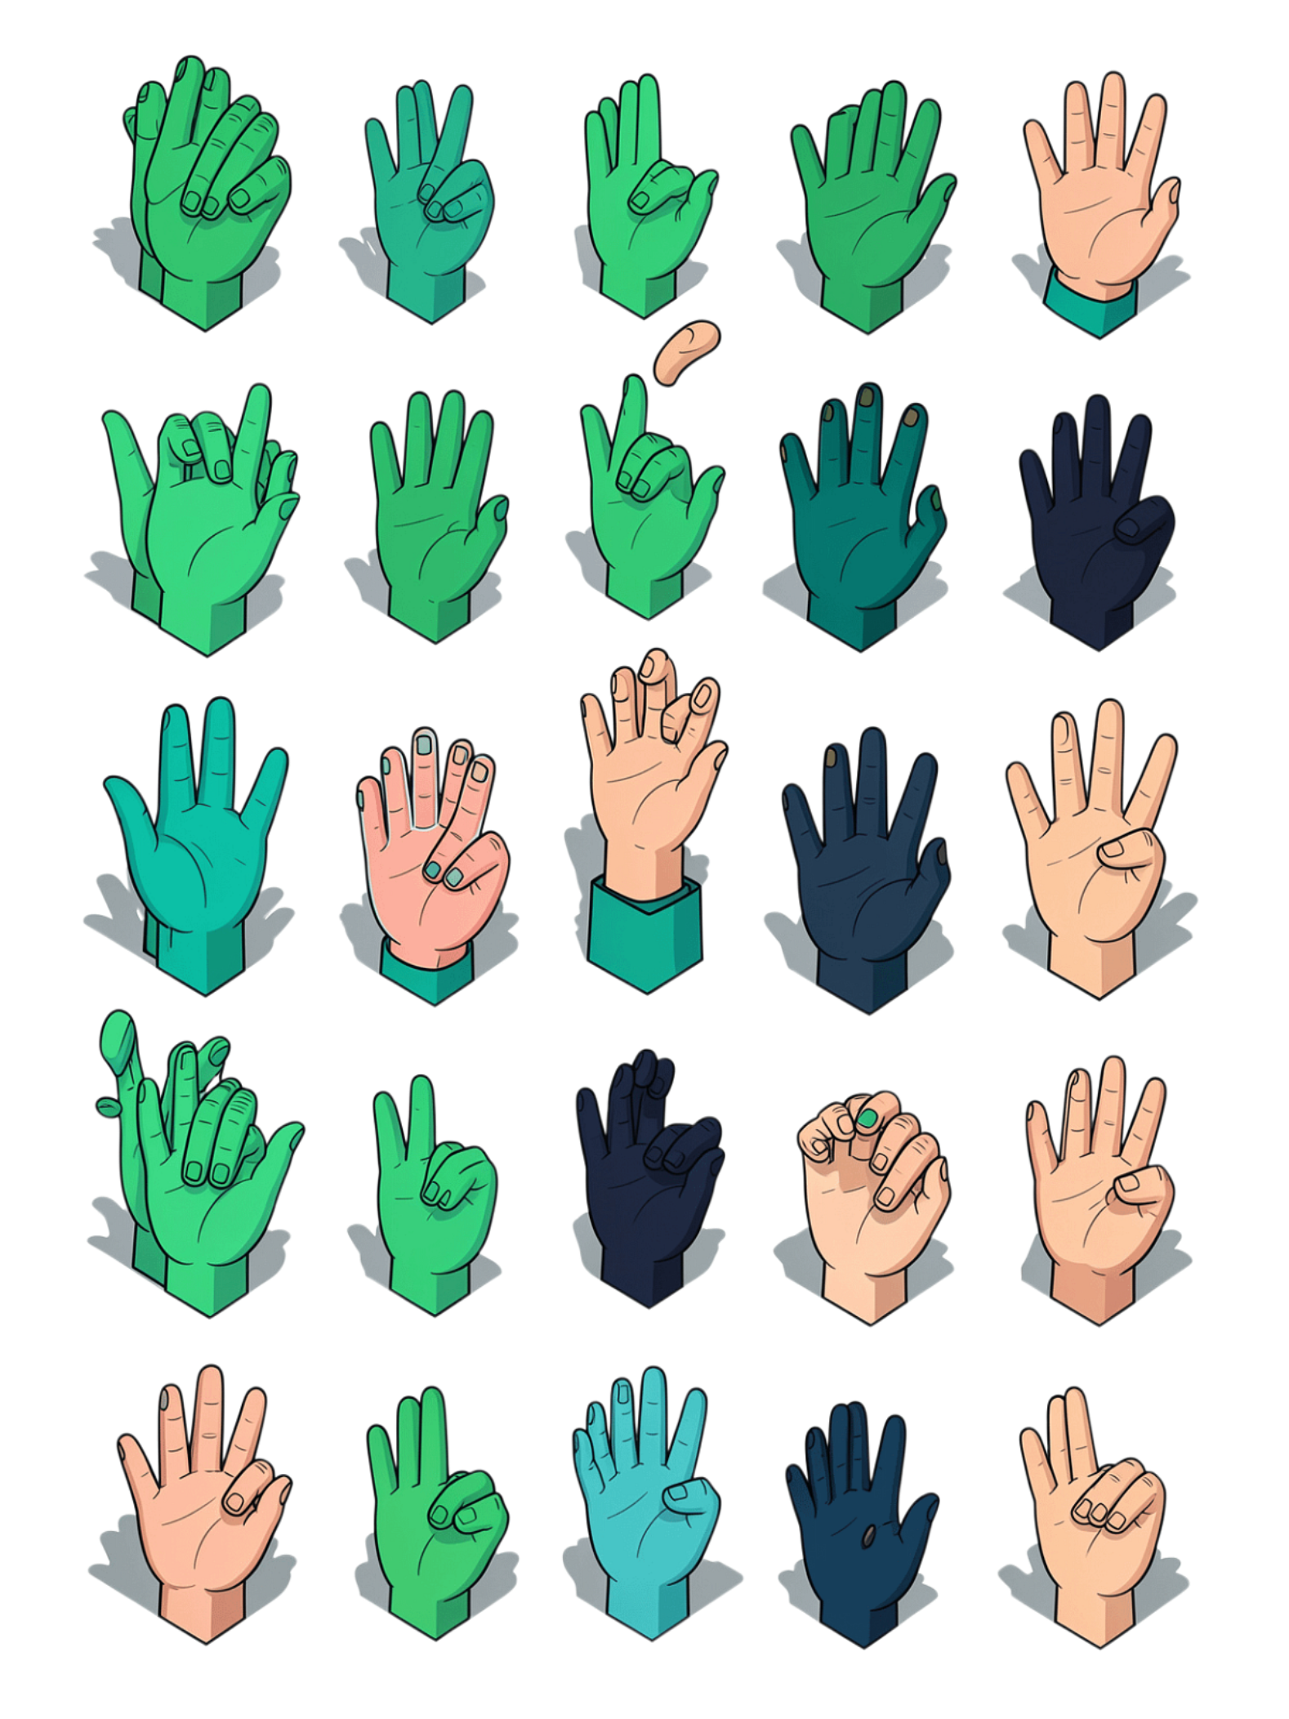
Dataset Overview
18,450
41
Total Images
Classes
41 classes × 450 images each, perfectly balanced
Digits, letters, and phrases: HELLO, YES, NO, THANK YOU, I LOVE YOU
224px
Input Size
224×224 RGB images — standard for MobileNetV2 backbone
Every class was validated before training to ensure consistent image quality across the full dataset.

Slide 5
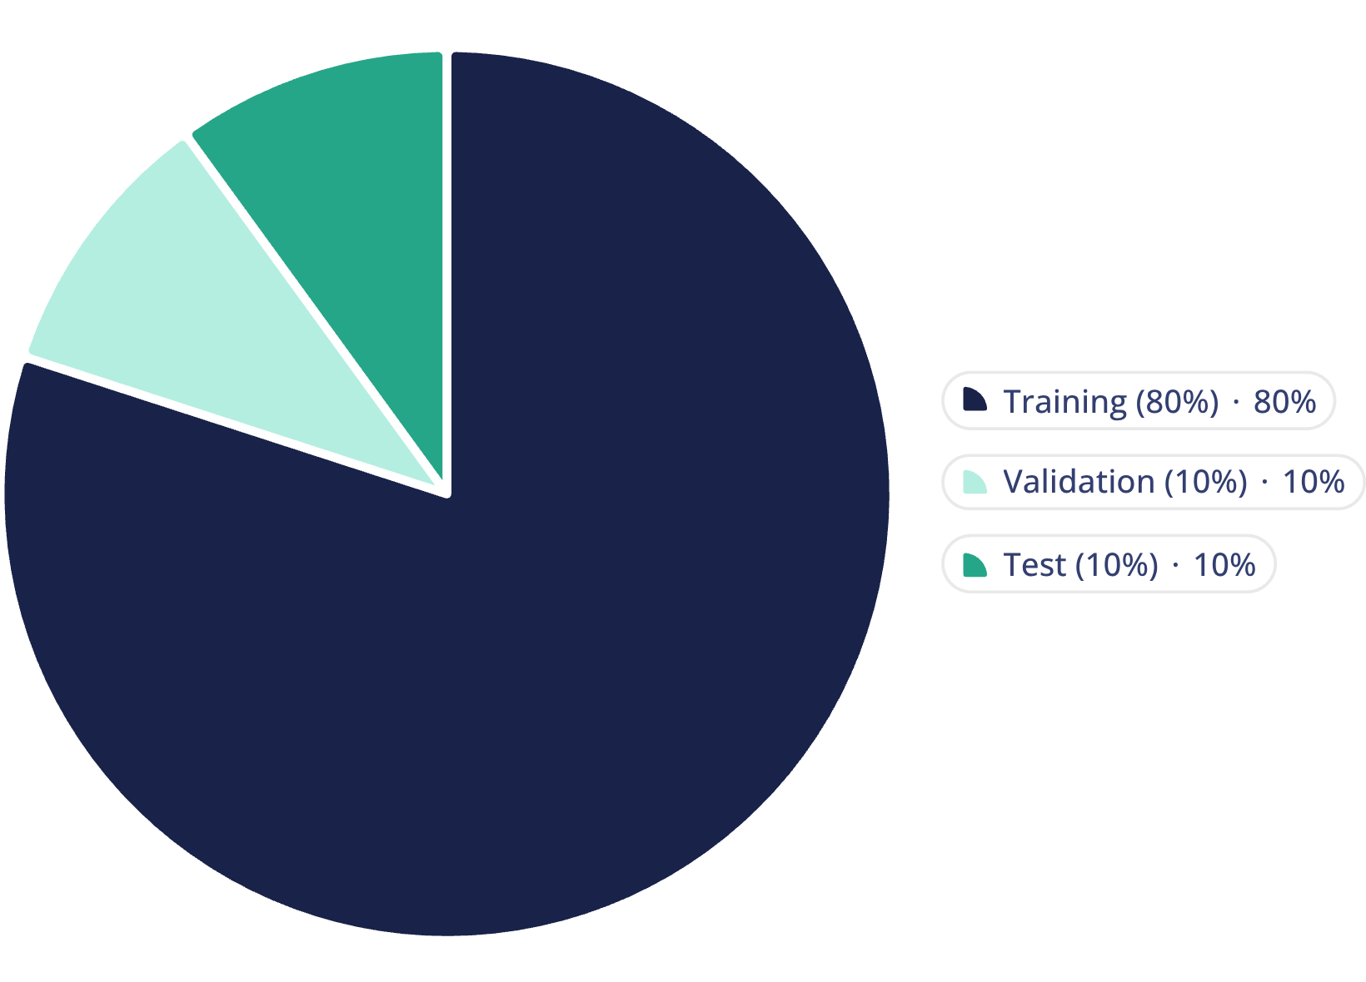
Data Split & Training Setup
Split Strategy
Stratified split (random state: 42) maintains class proportions across all sets
Per class: 360 training, 45 validation, 45 test images
Batch size: 32 for stable gradient updates
Balanced design ensures no class is over- or under-represented at any stage

Slide 6
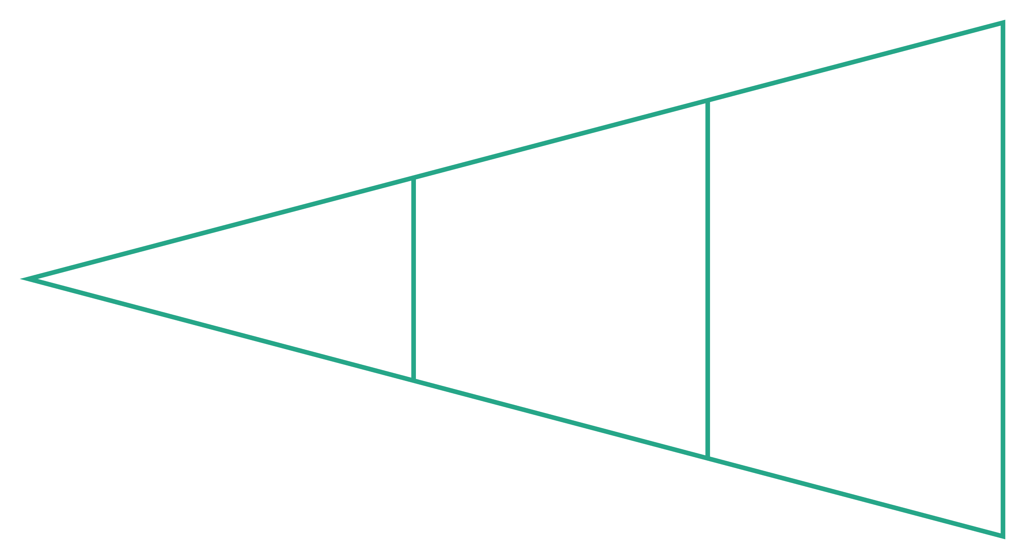
Deep Learning Pipeline
Input 224×224
Augmentation
Backbone
A two-stage training strategy — first warming up the classification head, then fine-tuning deeper MobileNetV2 layers with a reduced learning rate — unlocks the full representational power of the pretrained backbone for sign recognition.

Slide 7
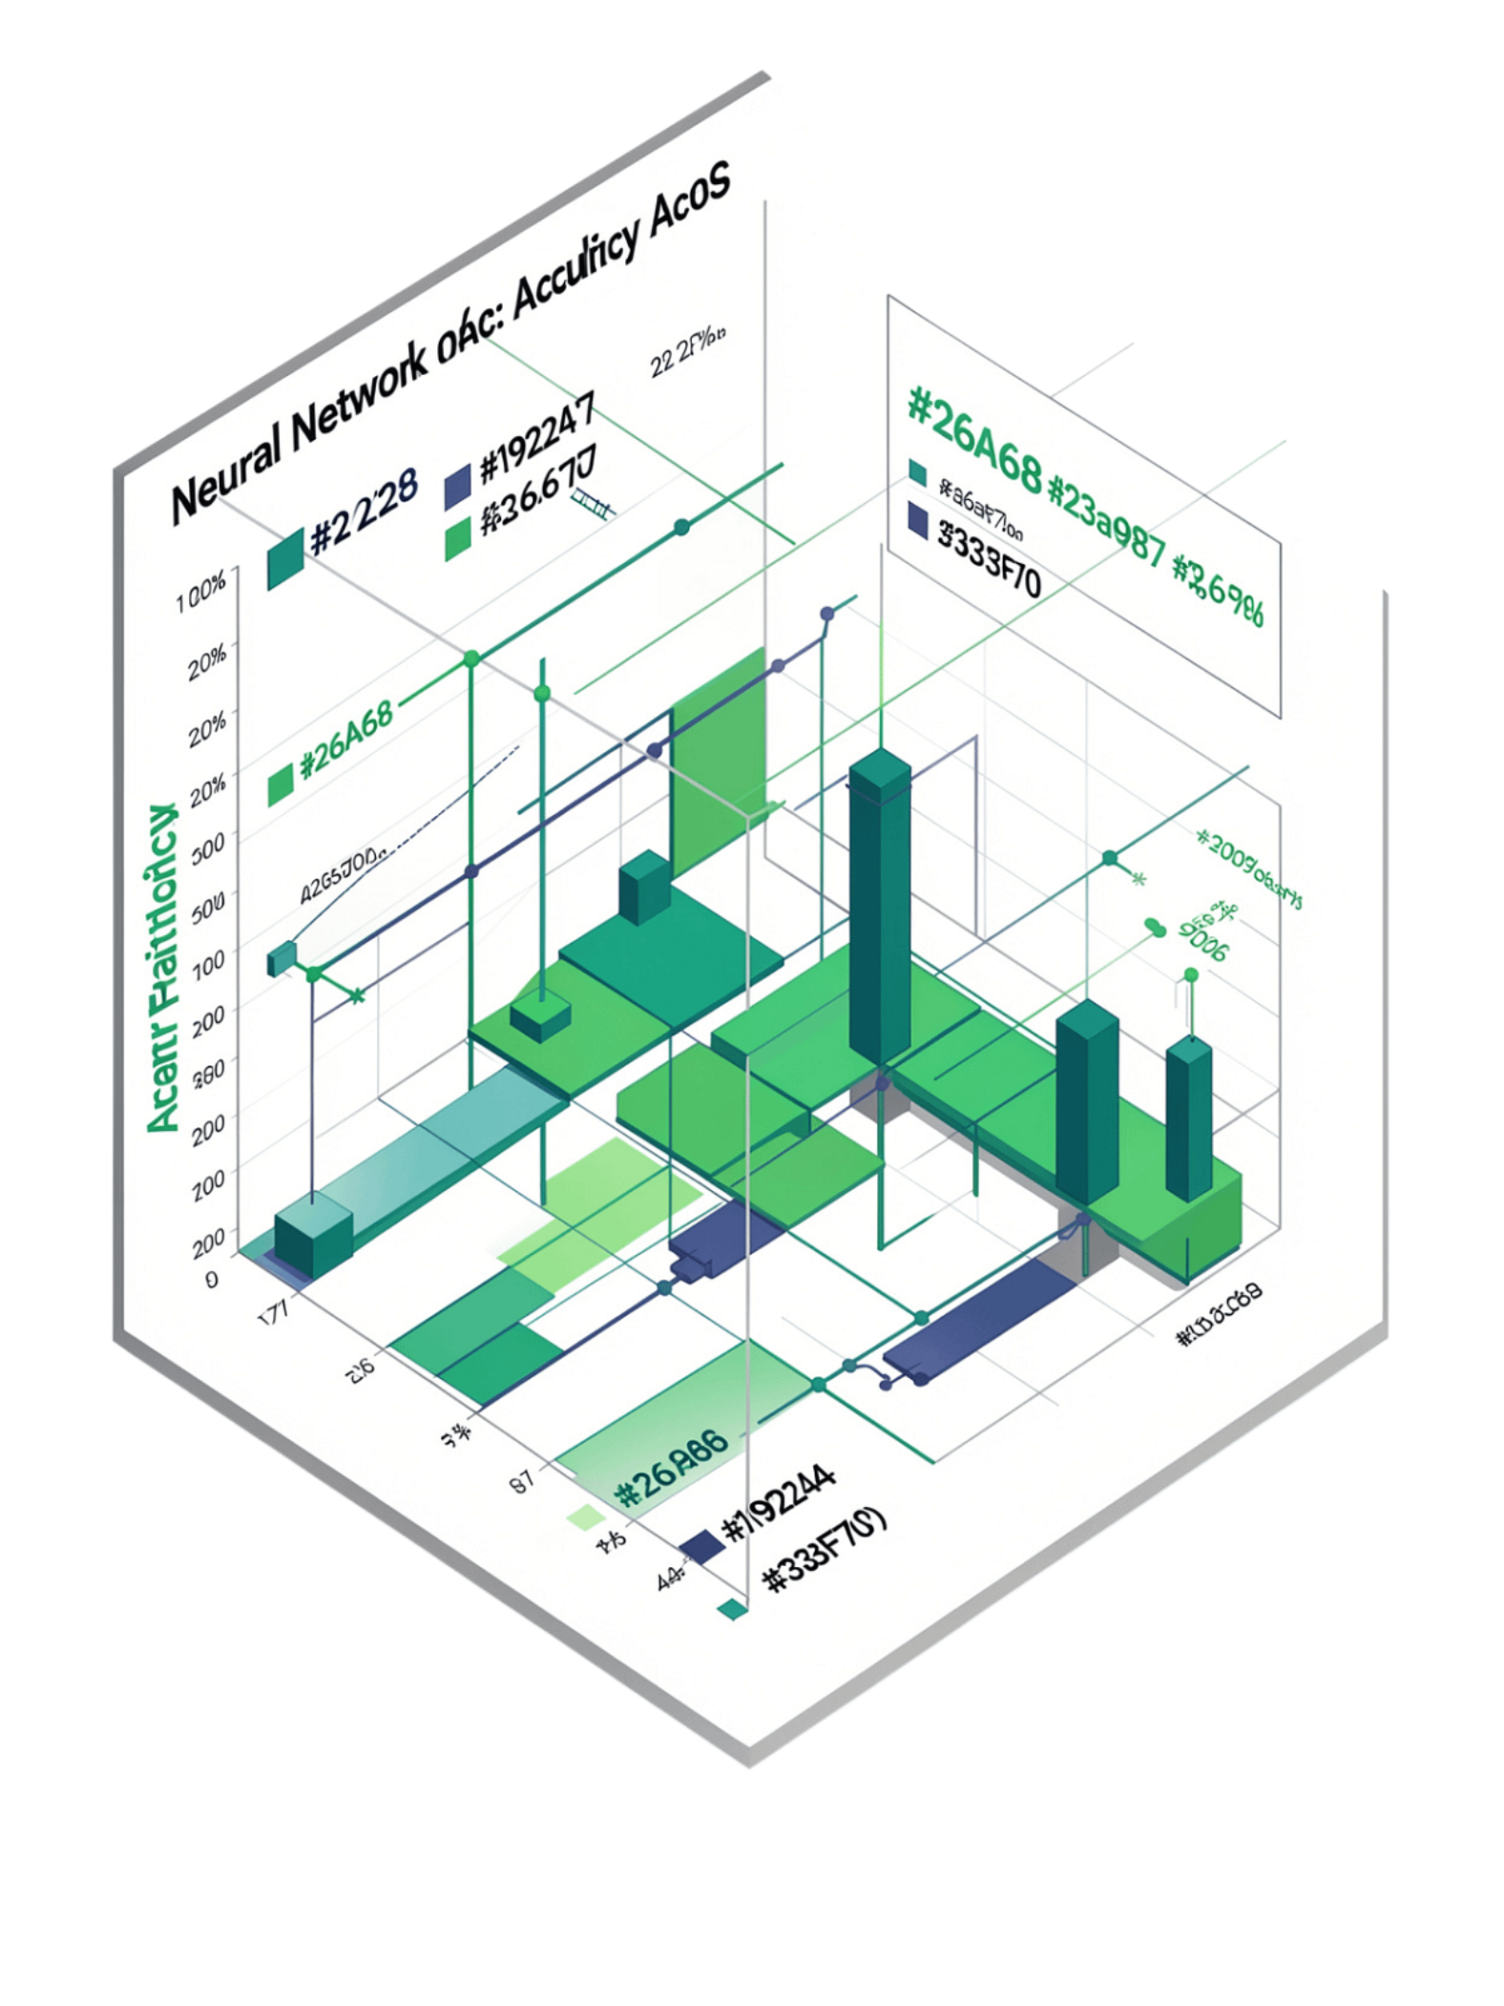
Results: 91.49% Accuracy
Test Accuracy
Macro F1-Score
91.49% on stratified test set — 1,845 held-out images
0.9148 — balanced performance across all 41 classes
Weighted F1-Score
0.9148 — confirms strong, consistent classification quality
The matching macro and weighted F1-scores reflect the perfectly balanced dataset — the model performs well not just on average, but across every individual sign class. Transfer learning proves highly effective for this domain.

Slide 8
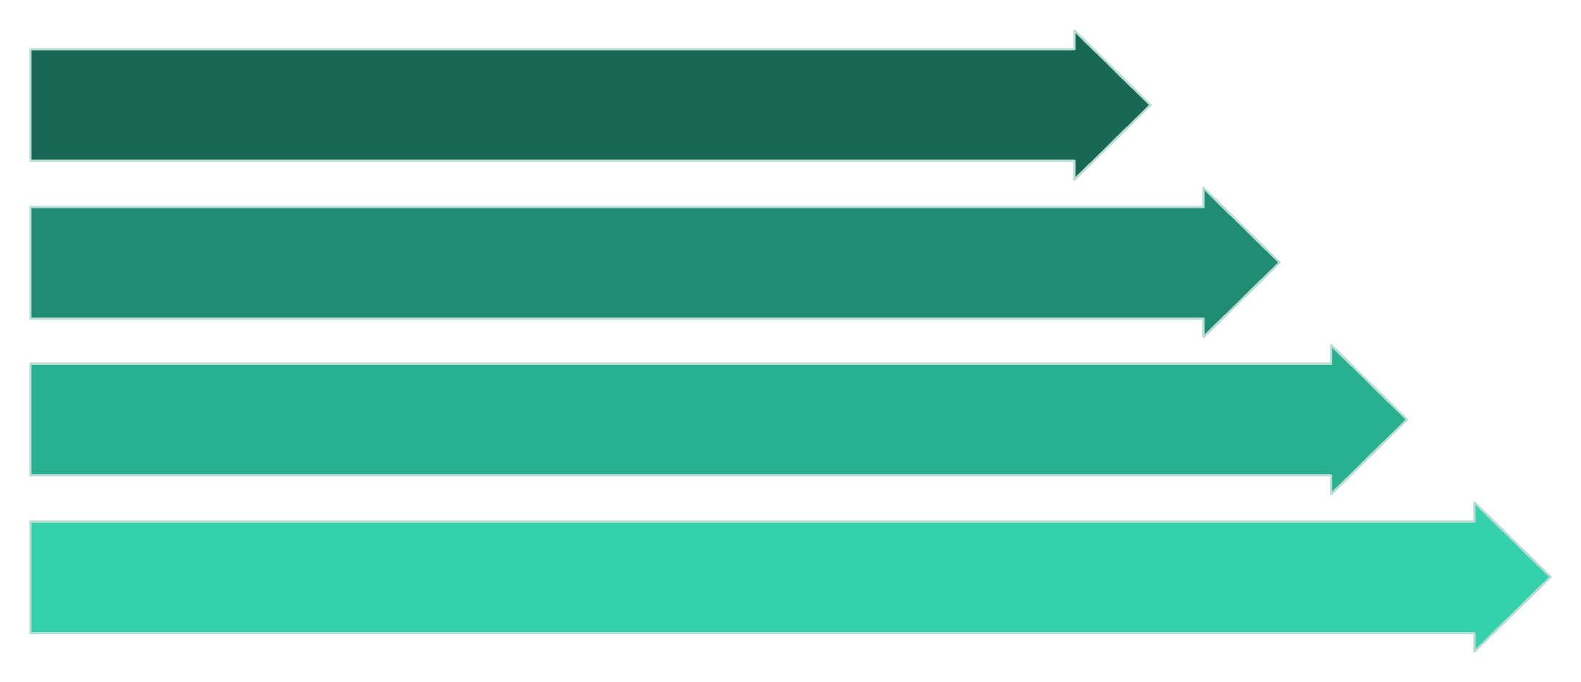

Tools & Real-Time Architecture
Training Stack
TensorFlow / Keras — model definition, training loops, callbacks
MobileNetV2 — pretrained backbone with ImageNet weights
Data augmentation pipeline integrated into training
Transfer learning + staged fine-tuning workflow
Target Real-Time Pipeline
Webcam Frame
OpenCV Process
Key Distinction
MediaPipe Landmarker
MediaPipe was NOT used to train the 91.49% classifier — it is explored separately as a preprocessing and deployment component for real-time inference.
CNN Sign Classifier

Slide 9
Key Insights
Transfer Learning Power
Balanced Data is Key
Lab-to-Webcam Gap
MobileNetV2's pre-trained weights were crucial, enabling high accuracy on a new, specific domain with less data and training time.
A perfectly balanced dataset (450 images/class) ensured fair model evaluation and consistent performance across all 41 sign classes.
Transitioning from controlled dataset accuracy to real-time webcam inference revealed critical challenges in variability and robustness.
Hybrid Tool Approach
Subtle Distinctions
Combining MediaPipe for hand detection with our CNN classifier offers a more robust, deployable solution for live video streams.
Highly similar sign pairs like M, N, S, T require meticulous feature extraction and calibration to prevent overconfident misclassifications.

Slide 10
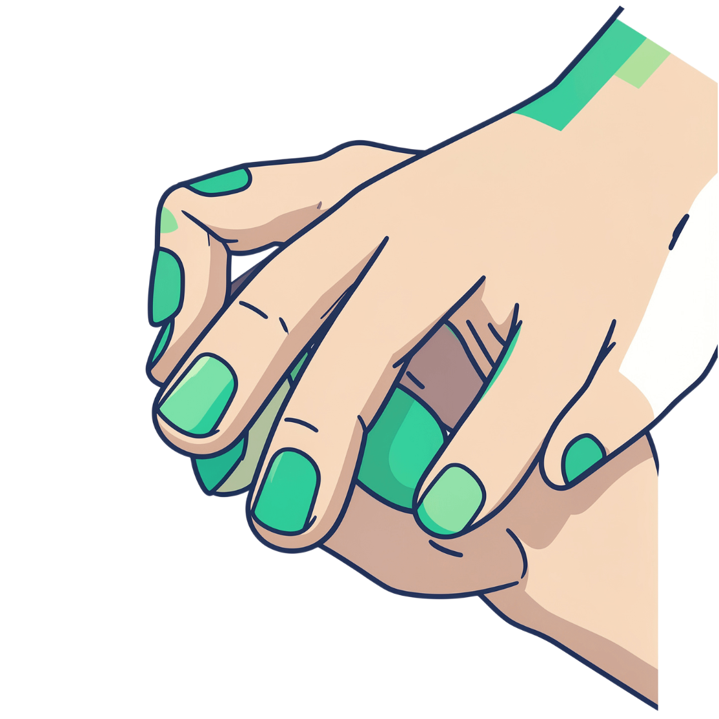
The Challenge
41 Distinct Classes
Classify 41 different static hand signs accurately from a single image frame.
Visually Similar Signs
Distinguish near-identical classes where tiny finger differences matter — M, N, S, and T are easily confused.
Real-World Variability
Handle changing backgrounds, lighting conditions, and hand positions in live webcam feeds.
Overconfident Predictions
Avoid high-certainty wrong predictions — calibration matters as much as accuracy.

Slide 11

Path Forward
Data & Robustness
Architecture & Modeling
Collect real webcam data with diverse backgrounds, lighting, and distances
Add targeted samples for confusing pairs: M/N/S/T
Use MediaPipe to consistently localize and crop hands before CNN inference
Introduce an Unknown/Uncertain class or confidence threshold to suppress low-quality predictions
Experiment with EfficientNet, MobileNetV3, or custom CNN architectures
Explore temporal models — LSTM, GRU, or Transformers — for dynamic gesture recognition
Perform class-wise error analysis to identify systematic failure modes
Apply confidence calibration techniques (temperature scaling, Platt scaling)
The gap between 91.49% lab accuracy and real-world webcam performance is not a failure — it is the clearest signal of where the next round of improvements should focus.

Slide 12
Key Takeaways
A balanced 41-class dataset with stratified evaluation provides a solid foundation
MobileNetV2 transfer learning + fine-tuning achieves 91.49% test accuracy
MediaPipe and OpenCV enable the bridge from research to real-time deployment
Model architecture and feature representation both matter—neither alone is enough
A hybrid MediaPipe + Deep Learning pipeline is the strongest path to real-world robustness
The gap between lab and webcam performance is a feature, not a bug—it drives meaningful improvements
Done by: Rashna, Francis, Sudeep

